Slide 1
Evaluation of Adult Kidney Transplant Candidates
By
Emad abokhabar
Lecturer of internal medicine and nephrology
Sohag university hospital

Slide 2
WHEN TO REFER
Kidney transplantation should be discussed with all patients with irreversible advanced CKD
CKD stage 4 or GFR less than 30 mL/min/1.73 m2
Early referral.

Slide 3
TRANSPLANTATION WORKUP
The purpose of the evaluation is to identify
Contraindications for kidney transplantation
Address and correct medical and psychological conditions that may affect transplant outcomes
Fitness

Slide 4
History and physical examination
Document the cause of renal disease and assess the risk of recurrence in the transplanted kidney.
Family history
Evidence of CVD, cerebrovascular disease, and peripheral vascular disease
Evidence of defects in coagulation
Evidence of abnormalities of the urinary tract and bladder

Slide 5
History and physical examination
Financial evaluation
Psychosocial
Evaluate sensitization risks
Retransplantation candidates

Slide 6
Contraindications for Kidney Transplantation
Severe uncorrectable systemic conditions with short expected life expectancy
Recent or untreatable malignancy
Uncontrolled psychiatric disorders and active substance abuse
Ongoing noncompliance
Chronic active infection
Primary oxalosis

Slide 7
Required tests
Blood type (need confirmatory test by 2 laboratories)
Complete blood count and comprehensive metabolic panel
Prothrombin time (PT), partial thromboplastin time (PTT)
Hepatitis serological tests
Cytomegalovirus serological test
Tissue typing for HLA and panel-reactive antibody (PRA)
Identification of specific HLA antibody should be performed in patients with positive PRA
Electrocardiogram (ECG)
Chest X-ray
Renal ultrasound

Slide 8
Optional laboratory tests
Purified protein derivative (PPD) test in those with a history of exposure to tuberculosis, prior residence in an endemic area, or chest X-ray suspicious of tuberculosis
Colonoscopy in patients older than 50 years
Mammogram in women older than 40 years
Prostate-specific antigen (PSA) in men older than 45 years

Slide 9
Optional laboratory tests
Serum immunoelectrophoresis in patients older than 60 years and those with unexplained renal failure and anemia
Stress test, echocardiogram, and cardiac angiogram (see cardiac section)
Vascular study (see vascular section)
Detailed coagulation study in those with history of deep venous thrombosis, spontaneous abortion, recurrent clotting of a dialysis fistula or graft, or bleeding tendency

Slide 10
CARDIAC EVALUATION*
All transplant candidates
History and physical examination to assess cardiovascular symptoms and signs, risk factors, and physical status
ECG for all patients.
Noninvasive screening to rule out occult CVD
Diabetes
Age older than 50 years,
Severe peripheral vascular disease,
Cigarette smoking history

Slide 11
Cardiovascular Disease
History & examination
Low risk
(Age < 45 yrs, no traditional risk factors)
Medium risk (Age > 45 yrs or any traditional risk factor)
High risk (angina +ve)
CAG
Stress test
-ve
+ve
Intensify conservative Management
Proceed with listing & review every 2 yrs
Appropriate intervention
Notes:
11

Slide 12
Cerebrovascular diseases
H/o stroke or TIA should be symptom free for at least 6 m before transplantation
Aspirin prophylaxis
Risk of perioperative bleeding is generally outweighed by the benefits

Slide 13
PERIPHERAL VASCULAR EVALUATION
Physical examination should focus on femoral and peripheral vascular arteries
Doppler studies of iliac and lower-extremity vessels

Slide 14
PULMONARY EVALUATION
Assessment of general anesthetic risk
Smoking cessation
A pulmonary function test
Chronic lung disease
Unexplained shortness of breath.

Slide 15
UROLOGICAL EVALUATION
Asymptomatic and absent history of bladder dysfunction do not usually require further evaluation.
Renal ultrasound
Chronic Kidney Disease Management
Anemia
Physiologic calcium, phosphorous, vit. D & PTH levels
Should not have a dialysis access infection or peritonitis at the time of transplantation.

Slide 16
UROLOGICAL EVALUATION
Urodynamic studies
Neurogenic bladder
Young patients with unexplained CKD
Voiding cystourethrogram
recurrent urinary tract infections
pyelonephritis
history of vesicoureteral reflux
history of urinary retention

Slide 17
UROLOGICAL EVALUATION
High PSA levels should be referred for a possible prostate biopsy
Indications for pretransplantation native nephrectomy
Chronic pyelonephritis
Infected stone
Heavy proteinuria.
Intractable hypertension.
Polycystic kidney disease with severely enlarged kidneys recurrent bleeding or infection.
Renal mass suspicious for renal cell carcinoma

Slide 18
IMMUNOLOGIC RISK
Panel reactive antibody (PRA; range 0%–100%).
Preformed antibodies
prior transplantations
Pregnancies
blood transfusions
Tests to detect preformed HLA antibodies
Enzyme-linked immunosorbent assay (ELISA),
Flow cytometry, and
Cytotoxicity test to assess PRA
The PRA is generally measured at the time of transplant evaluation and then periodically (every 3 mth)

Slide 19
IMMUNOLOGIC RISK
PRA declines with time, especially if blood transfusions are avoided
HLA - graft survival is better with fewer mismatches (range 0-6)
Blood group-compatible (Except when donor is BG A2)
Final cross-match that measures whether the recipient has an antibody to the donor kidney
Highly sensitized patients

Slide 20
EVALUATION OF COMORBID CONDITIONS
Diabetes
In patients with type 1 diabetes with ESRD, early transplantation with a living donor followed by pancreas-after kidney transplantation usually is regarded as the best option
Simultaneous kidney-pancreas transplantation
Due to t he high prevalence of vascular disease, patients should be screened vigorously for peripheral and coronary artery disease

Slide 21
EVALUATION OF COMORBID CONDITIONS
Obesity
Morbid obesity is associated with increased risk of
graft loss
Delayed graft function
Wound complications
Prolonged hospitalization.
New-onset diabetes after transplantation,
Weight loss often is recommended before transplantation
Most centers will decline candidates when BMI is greater than 40 kg/m2

Slide 22
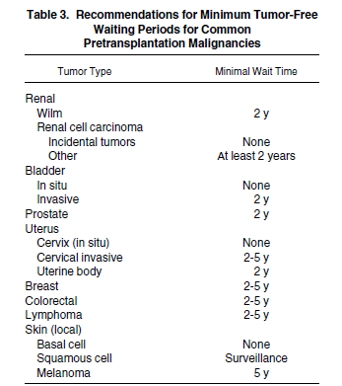
Patients with history of cancer

Slide 23
Hepatitis C infection
Liver biopsy should be performed to evaluate the extent of liver damage
Cirrhosis is a contraindication for kidney transplantation due to increased mortality in this group
Consideration should be given to treatment of patients with hepatitis C before transplantation
The option of hepatitis C–positive donor transplantation should be discussed with patients with active hepatitis C given the shorter waiting time for hepatitis C deceased donor kidney and acceptable outcome

Slide 24
Anti HCV +ve
HCV RNA -ve
HCV RNA +ve
Liver Bx
Normal LFT
Cirrhosis or precirrhosis
Normal
Hepatitis
List fro renal transplant
Antiviral Rx
Refer transplant or consider combined liver-kidney transplant
HCV RNA -ve
HCV RNA +ve
Pt by pt decision
Notes:
24

Slide 25
Hepatitis B infection
Hepatitis B infection is no longer considered an absolute contraindication for transplantation
Patients with past natural infection with detectable antibody to hepatitis B surface antigen (HBsAb) and negative hepatitis B surface antigen (HBsAg) antiviral prophylaxis may be beneficial
Liver biopsy should be performed in patients with active hepatitis B; if advanced liver disease is detected, patients should be referred for combined liver-kidney transplantation
Antiviral treatment should be initiated in patients with active viral replication (positive hepatitis B e antigen [HBeAg] or hepatitis B virus DNA)

Slide 26
SLE and vasculitis
Transplantation should be delayed until patients have no clinically active disease and are on minimal immunosuppressive therapy
Previous treatment with steroids increases the risk of bone disease
Exposure to cytotoxic agents increases the risk of bone marrow toxicity and posttransplantation malignancy

Slide 27
Polycystic kidney disease
Pretransplantation nephrectomy
Extrarenal manifestations, such as aneurysm, valvular heart disease, and diverticulosis, may complicate the transplantation course, and screening should be performed in suspected cases

Slide 28
Primary oxalosis
Primary oxalosis is a contraindication for single-organ kidney transplantation, and patients should be referred for combined liver-kidney transplantation

Slide 29
Advanced age
Patients older than 60 years are at a greater risk of posttransplantation infection and are more susceptible to medication side effects
Appropriately evaluated and educated patients in their 70s may benefit in terms of life expectancy from transplantation and may be considered as transplant candidates
There are limited data on outcomes for patients in their late 70s and early 80smost of these patients are better served by remaining on dialysis therapy

Slide 30
Primary glomerular disease
Most, but not all, glomerular disease may recur after transplantation
Primary focal sclerosis may recur in 20% to 50% after kidney transplantation risk factors include younger age and rapid progression in native kidneys

Slide 31
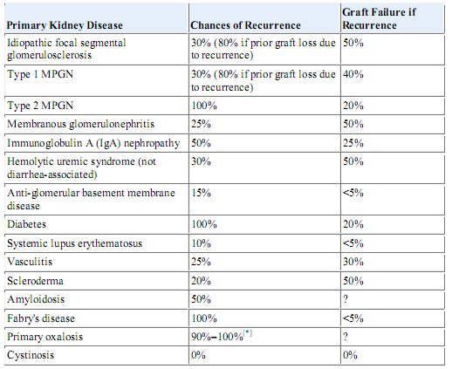
Recurrent Kidney Disease

Slide 32
Noncompliance and Cognitive Impairment
Substance abuse – substance free for at least 6 months before being accepted for transplantation.
Patients with cognitive impairment should probably not undergo transplantation

Slide 33
CONCLUSION
Kidney transplantation should be discussed with all patients with irreversible advanced CKD
In all candidate CV symptoms and signs, risk factors, and physical status must be assessed
Doppler studies of iliac and lower-extremity vessels in patient with risk for PAD
Smoking cessation is a must before transplantation.
PRA must be done in sensitized patient.
HLA - graft survival is better with fewer mismatches.
Consideration should be given to treatment of patients with hepatitis C before transplantation
Most, but not all, glomerular disease may recur after transplantation .

Slide 34
Thank you

